Slide 1


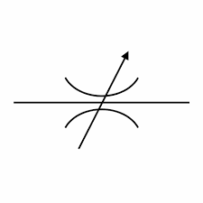

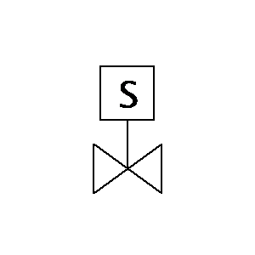

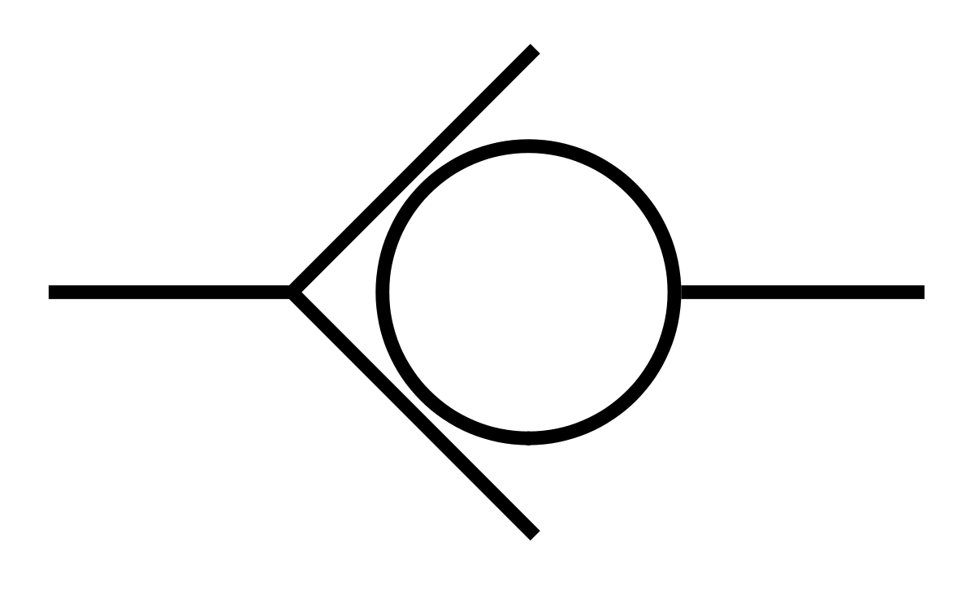

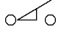
19-08-2020
ELECTRONIC ARCHITECTURE
AIR
TO MASK
FROM MASK
HEPA FILTER
Error correction
for lpm
HEPA FILTER
HMEF FILTER
Gray is the motherboard
Red is the Power PCB
Sensor
Analog
Oxygen blender
5
7
15
Control PEEP and PIP
4
BUFFER MEMBRANE
14
White is a loose component
Green is a driver PCB
High Current Driver
1
8
16
Circuit
6
13
2
3
02 cell
17
Physical housing section
Light Blue is the Cherry PCB
Digital
Set LPM
Set %02
9
EXHAUST
Actuator
O2
Bellow
C02 cell
Yellow is the MCU PCB
Actuator
10
18
11
Dark blue is the 02 PCB
Power Electronics
12
Limit Switch
CENTRAL CHANNEL
Solenoid (3)
Solenoid (2)
12V
LCD and LCD Driver
TOP
12V
BOT
12V
Connector
3,3V
Pressure Sensor (7)
Battery Management
14,8V
3,3V
Battery Pack
LED
Buzzer
Touch Sensor
Touch Sensor Driver
MCU
3,3V
3,3V
Pressure Sensor (13)
3,3V
VSO Driver for LPM (2.1)
VSO Driver for %O2 (3.1)
12V
12V
24V
PSU
Stepper Motor Driver (11.1)
12-24V
Pinch Valve Driver (8.1)
Pinch Valve Driver (11.1)
Pinch Valve Driver (14.1)
Mezzanine onto Mother
12V
12V
12V
5V
Cherry Blossom
MOTHERBOARD
Solenoid (14)
Solenoid (11)
12V
Solenoid (8)
12V
Cherry Blossom
HDMI Stacker
12V
MOTHERBOARD
Cherry Blossom
Wi-Fi Stacker
Stepper Motor (11)
Mass Flow Sensor (4)
Mass Flow Sensor (12)
Limit Switch (12)
12V
Oxygen Sensor analog circuit
Oxygen Sensor (6)

Slide 2
19-08-2020
LOOMS AND WIRING
AIR
TO MASK
FROM MASK
HEPA FILTER
Error correction
for lpm
HEPA FILTER
HMEF FILTER
Gray is the motherboard
Sensor
Analog
Oxygen blender
5
7
15
Control PEEP and PIP
Digital
4
BUFFER MEMBRANE
14
White is a loose component
1
8
16
Circuit
I2C
6
13
UART
2
3
02 cell
17
Physical housing section
Set LPM
Set %02
9
EXHAUST
Actuator
Power
O2
Bellow
C02 cell
High Current Driver
10
18
11
12
Limit Switch
CENTRAL CHANNEL
Solenoid (3)
Solenoid (2)
12V
BOT
LCD and LCD Driver
TOP
12V
12V
Connector
3,3V
Pressure Sensor (7)
Battery Management
14,8V
3,3V
Battery Pack
LED
Buzzer
Touch Sensor
Touch Sensor Driver
MCU
3,3V
3,3V
Pressure Sensor (13)
3,3V
VSO Driver for LPM (2.1)
VSO Driver for %O2 (3.1)
12V
12V
24V
PSU
Stepper Motor Driver (11.1)
12-24V
Pinch Valve Driver (8.1)
Pinch Valve Driver (11.1)
Pinch Valve Driver (14.1)
Mezzanine onto Mother
12V
12V
12V
5V
Cherry Blossom
MOTHERBOARD
Solenoid (14)
Solenoid (11)
12V
Solenoid (8)
12V
Cherry Blossom
HDMI Stacker
12V
MOTHERBOARD
Cherry Blossom
Wi-Fi Stacker
Stepper Motor (11)
Mass Flow Sensor (4)
Mass Flow Sensor (12)
Limit Switch (12)
12V
Oxygen Sensor analog circuit
Oxygen Sensor (6)

Slide 3
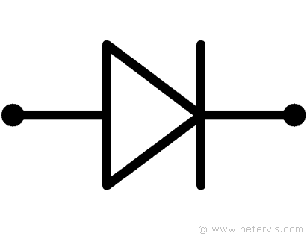
19-08-2020
POWER SUPPLY ARCHITECTURE
FLOATING
STEPPER MOTOR DRIVER
12VDC-48VDC
STEPPER MOTOR
Short circuit protection – Fuses only?
IDEAL
DIODE
L
Filter
ISOLATED AC/DC
220VAC – 24VDC
150W
SYSTEM SUPPLY
10,5 – 24VDC
IDEAL
DIODE
N
LEAD CRYSTAL BATTERY
10,5-13,5VDC
BATTERY CHARGE
CONTROLLER
E

Slide 4
19-08-2020
POWER DISTRIBUTION AND GROUNDING
Use of linear regulators
Low EMI and cheaper.
Low power consumption on boards makes the lower inefficiency acceptable.
HYBRID GROUNDING: SINGLE POINT AND MULTI POINT
Common-ground impedance can result in noise.
Gauge of ground wire?
LCD and LCD Driver
TOP
CENTRAL CHANNEL
BOT
12V
220VAC to 24VDC
L
Filter
N
Is this a daisy chain ground?
E
Switching DC-DC
24VDC to 12VDC
Linear DC-DC
12VDC to 5VDC
Linear DC-DC
5VDC to 3,3VDC
Linear DC-DC
12VDC to 3,3VDC
Switching DC-DC
24VDC to 12VDC
LED
Buzzer
Mezzanine onto Mother
Connector
Connector Stackers
Stepper Motor Driver (11.1)
3,3V
3,3V
3,3V
12-24V
MCU
Solenoid Driver Board
12V
5V
Cherry Blossom
Touch Sensor
Touch Sensor Driver
Stepper Motor (11)
Cherry Blossom
HDMI Stacker
Limit Switch (12)
12V
MOTHERBOARD
Cherry Blossom
Wi-Fi Stacker
MOTHERBOARD

Slide 5
19-08-2020
POWER DISTRIBUTION AND GROUNDING
Use of linear regulators
Low EMI and cheaper.
Low power consumption on boards makes the lower inefficiency acceptable.
HYBRID GROUNDING: SINGLE POINT AND MULTI POINT
Common-ground impedance can result in noise.
Gauge of ground wire?
LCD and LCD Driver
TOP
CENTRAL CHANNEL
BOT
12V
220VAC to 24VDC
L
Should this be an isolated DC/DC to prevent ground loop?
Filter
N
Should this be an isolated DC/DC to prevent ground loop?
E
Isolated Switching DC-DC
24VDC to 12VDC
Linear DC-DC
12VDC to 5VDC
Linear DC-DC
5VDC to 3,3VDC
Linear DC-DC
12VDC to 3,3VDC
Isolated Switching DC-DC
24VDC to 12VDC
Filter
Mezzanine onto Mother
Connector
Connector Stackers
Stepper Motor Driver (11.1)
LED
Buzzer
12-24V
3,3V
3,3V
3,3V
MCU
Solenoid Driver Board
5V
12V
Cherry Blossom
Touch Sensor
Touch Sensor Driver
Cherry Blossom
HDMI Stacker
Cherry Blossom
Wi-Fi Stacker
Stepper Motor (11)
MOTHERBOARD
12V
MOTHERBOARD

